Slide 1
By Georgia Vine (She/Hers) - BSc Hons Occupational Therapy Graduate 2021

Slide 2
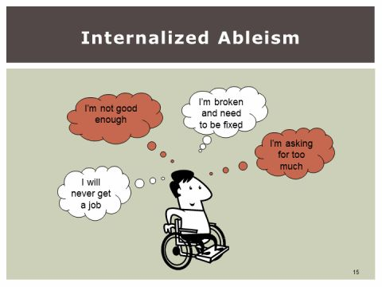
What is Ableism?
“Ableism is discrimination in favour of non-disabled people.” (Scope n.d.)
“The term disablism refers to the ways in which people with impairments are disabled and disadvantaged by ableism’s inequitable social structures and unjust practices.” (Hammell, 2020)
Ableism results in internalised ableism…
“Internalized oppression is not the cause of our mistreatment; it is the result of our mistreatment. It would not exist without the real external oppression that forms the social climate in which we exist. Once oppression has been internalized, little force is needed to keep us submissive. We harbour inside ourselves the pain and the memories, the fears and the confusions, the negative self-images and the low expectations, turning them into weapons with which to re-injure ourselves,
every day of our lives.” (Marks 1999)
Source: (Palacios 2017)

Slide 3
The Effects of Ableism Within Occupational Therapy Practice
●Accessibility when attending training/conferences.
●Lack of part time roles.
●Lack of virtual and remote roles.
●The fight for access to reasonable adjustments.
●Reduction in leadership and research opportunities which results in lower income.
●Little research on the impact of ableism in the profession.
●Risk of delivering poor practice if we do not address this ableism
●We do this whilst recognising intersectionality. WE ARE STRONGER TOGETHER

Slide 4
How You and Your Region Can Challenge Ableism
● Challenge ableism in the workplace.
Find out what level of disability confident employer your workplace is and ask them why? If this isn’t the highest level then why?
Get involved with AbleOTUK.
Think critically about the points raised in this presentation and see if you can make small changes.
Create a safe space for you disabled colleagues and services uses to have these conversations.
Get comfortable using language such as ableism.

Slide 5
Everyday Ableism
Asking someone what’s wrong with them.
Failure to make workplace adjustments.
Failure to make buildings accessible.
Inequalities to accessing healthcare.
Viewing disabled people as tragic or inspirational.
Believing that all disabilities are visible.
Can you think of a time where you have been unintentionally ableist?
Source: University and College Union n.d.

Slide 6
How to be an Ally
Treat disabled people like you would non-disabled people.
Listen to voices of disabled people and seek out different views.
Challenge your own assumptions.
Don’t expect disabled people to teach you.
Challenge disability discrimination.
Don’t assume a disabled person’s life is less than yours.
Source: University and College Union n.d.

Slide 7
  References
Campbell, K. F. (2009). Contours of Ableism. Palgrave Macmillan: London. [Online.] Retrieved from https://doi.org/10.1057/9780230245181_2
Whally, Hammell, K. (2020), Engagement in Living: Critical Perspectives on Occupation, Rights and Wellbeing. CAOT Publications ACE. [Online.] Retrieved from. https://caot.ca/client/product2/908/item.html
Palacios, M. R. (2017). Internalised Ableism. The Other Side of Ableism. [Online.] Retrieved from https://cripstory.wordpress.com/2017/07/06/the-other-side-of-ableism/
Scope. (n.d.). Disablism and Ableism. [Online.] Retrieved from https://www.scope.org.uk/about-us/disablism/
University and College Union. n.d. Everyday Ableism. [Online.] Retrieved from https://www.ucu.org.uk/media/11222/Everyday-Ableism/pdf/Everyday_Ableism.pdf

