Slide 1
The power of occupational therapy
Transforming health and social care
Notes:
Please amend this presentation to make it relevant to you and the people you are talking with.

Slide 2
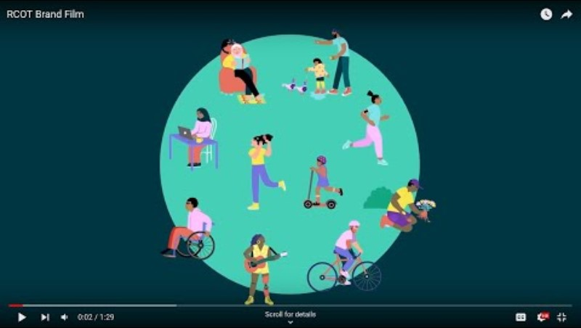
Notes:
This slide should play a video automatically when clicked on in slide view.

Slide 3
Occupational therapy plays a vital role in health, social care and society.
It enables people to manage their health and care needs and do the occupations that they want, need and like to do.
Notes:
What is occupational therapy?
Occupational therapy plays a vital role in health, social care and society.
It enables people to have fulfilling lives at home, at work, at school – and everywhere else – through meaningful occupations. It enables people to manage their health and care needs and to do the occupations that they want, need and like to do.
Occupational therapists consider all aspects of an individual and their environments and work with them to create a plan to reach their goals.

Slide 4
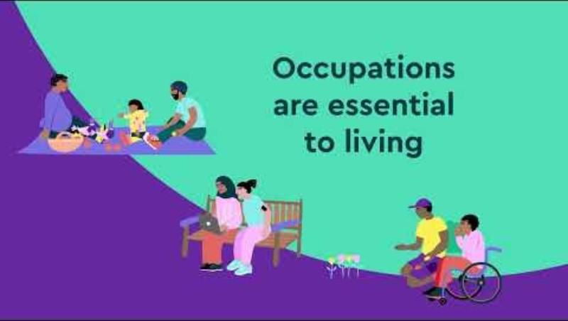
Notes:
This slide should play a video automatically when clicked on in slide view.
What are occupations?
An occupation isn’t just your job or activities of daily living.
An occupation can be looking after yourself, such as washing, eating or sleeping; productive, such as work, study, caring or domestic activities; and leisure, such as playing sports, hobbies or socialising.
An occupation is any meaningful activity that supports physical, mental, emotional and spiritual wellbeing.

Slide 5

Notes:
This slide should play a video automatically when clicked on in slide view.
What are occupations?
An occupation isn’t just your job or activities of daily living.
An occupation can be looking after yourself, such as washing, eating or sleeping; productive, such as work, study, caring or domestic activities; and leisure, such as playing sports, hobbies or socialising.
An occupation is any meaningful activity that supports physical, mental, emotional and spiritual wellbeing.

Slide 6
Growing demand for occupational therapy
The UK currently has approximately six occupational therapists per 10,000 people. The demand on our service is already stretched.
By 2035:
the population in the UK is projected to be 69.2 million
two-thirds of adults aged over 65 are projected to be living with multiple health conditions
two in five people aged 75 years or over, with an unplanned hospital admission, will die within a year – a quarter of them will spend more than a month of this precious last year in hospital.
Notes:
The UK currently has approximately six occupational therapists per 10,000 people. The demand on our service is already stretched.
By 2035:
the population in the UK is projected to be 69.2 million
two-thirds of adults aged over 65 are projected to be living with multiple health conditions
two in five people aged 75 years or over, with an unplanned hospital admission, will die within a year – a quarter of them will spend more than a month of this precious last year in hospital.

Slide 7
Occupational therapy is a solution to many of the UK’s health and care needs.
By prioritising prevention and early intervention, occupational therapists help people manage their health and reduce the frequency and need for crisis interventions and care services.
Notes:
Why do we need occupational therapy?
Occupational therapy is a solution to many of the UK’s health and care needs.
By prioritising prevention and early intervention, occupational therapists help people manage their health and reduce the frequency and need for crisis interventions and care services.
This will help people to manage their symptoms and needs, and reduce the requirement for hospital and specialist services.

Slide 8
By helping people live well for longer, occupational therapy saves money and reduces pressure on health and care services.
Within integrated health and care systems, occupational therapists can deliver better outcomes and create a more sustainable system for all.
Notes:
What’s the value of occupational therapy?
By helping people live well for longer, occupational therapy saves money and reduces pressure on health and care services.
Within integrated health and care systems, occupational therapists can deliver better outcomes, reduce strain on health and social care resources, and create a more sustainable system for all.

Slide 9
The occupational therapy workforce needs to be positioned in communities.
By working proactively with people where they are, we will empower them to manage their changing needs and reduce pressure on the NHS and the wider health and care system.
Notes:
Where is occupational therapy needed?
The occupational therapy workforce needs to be positioned in communities to focus on prevention and early intervention.
With an ageing population and an increasing complexity of needs, the requirement for occupational therapy will only rise.
By working proactively with people where they are, we will empower people to manage their changing needs and reduce pressure on the NHS and the wider health and care system.

Slide 10
Delivering impact
Reduced time from first assessment with a community OT to discharge by 8 weeks
OTs using AI reduced resident falls by 35% and attendance to emergency departments by 60%
OT services in primary care blended delivery model resulted in 60% fewer GP appointments
43% reduction in referral to local adult community mental health from
OTs working in GP surgeries
Notes:
Occupational therapist in Wrexham and Flintshire streamlined the referral process and clinical approach reducing the time of patients first assessment with a community OT to discharge from 17 weeks to on average 9 weeks. Aligning the community OT service with the multidisciplinary teams within GP clusters the service was easier to access, reduced waiting times and improved patient outcomes.
Multidisciplinary teams involving occupational therapists in Somerset are using AI to identify individuals at risk of unplanned hospital admissions. Those identified can then be invited to take part in an OT assessment. Pilots have successfully reduced resident falls by 35%, attendances to Emergency Departments by 60% and ambulance callouts by 8.7%.
The Lanarkshire Primary Care occupational therapy service established a blended delivery model in 2017, offering online, phone, home, community and in-person consultations. Users of the service, which supports individuals facing functional decline due to physical or mental health issues, reported 86% improved function, 94% greater satisfaction with roles, and 93% improved mental wellbeing. Additionally, 60% of users required fewer GP appointments, increasing primary care capacity through OT interventions.
In Northern Ireland, three occupational therapists working as Mental Health Practitioners in GP surgeries, as part of a multidisciplinary team are improving lives and driving efficiencies in primary care. In three months they provided over 6,000 consultations in the Causeway GP Federation area, which resulted in 97% of patients, who responded to a survey, being very satisfied or satisfied. The local adult community mental health teams also reported a 43% reduction in referral rates.

Slide 11
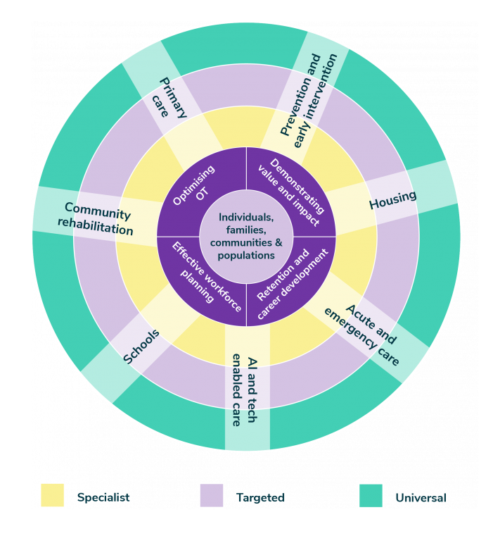
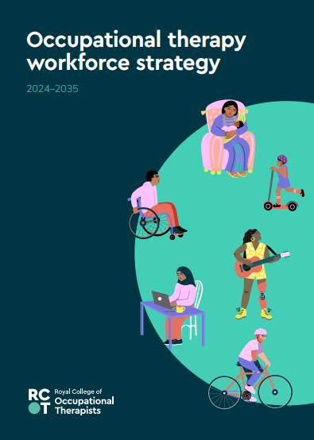
Positioning occupational therapy for the future
Notes:
Prevention and early intervention: Occupational therapists can support people to prioritise their health and wellbeing and balance work and life roles to live healthier for longer. To meet population need, a focus on prevention and early intervention will help people living with multiple health conditions to manage their symptoms and reduce the need for hospital and specialist services. We will help people to live well in their communities despite having a long-term condition(s).
Acute and emergency care: Hospital at home/virtual wards will reduce how often older people and people living with ongoing health conditions need to be admitted into hospital. There will, however, always be a need for hospital services when people experience injury, mental health crisis or need medical interventions such as surgery.
AI and tech enabled care: Occupational therapists will use digital health and care technology to enable people to safely carry out their daily occupations to live well. Building on existing technology such as sensors, wearables and apps, we see AI and technology augmenting the role of occupational therapy.
Universal, targeted and specialist delivery: To make the best use of occupational therapy expertise, services will be designed based on a universal, targeted and specialist tiered delivery.
Workforce planning and retention: Occupational therapy practitioners will expect to have several careers during their working life and will seek a working culture that embraces inclusion and offers flexibility, including portfolio working. Planning of workforce numbers will need to reflect these expectations, to allow for higher numbers of occupational therapists working outside the statutory sector. When and where the NHS cannot meet demand, independent providers of occupational therapy will offer services to people who can self-fund. This market will mostly grow in England, where fewer people are eligible for state funded care.
To realise this future and to transform and expand the occupational therapy workforce we have a three-year action plan.

Slide 12
Occupational therapy is the key to many people’s better futures.
It needs be included in the strategic planning and allocation of resources to manage health, education, housing and care needs in the UK.

Slide 13
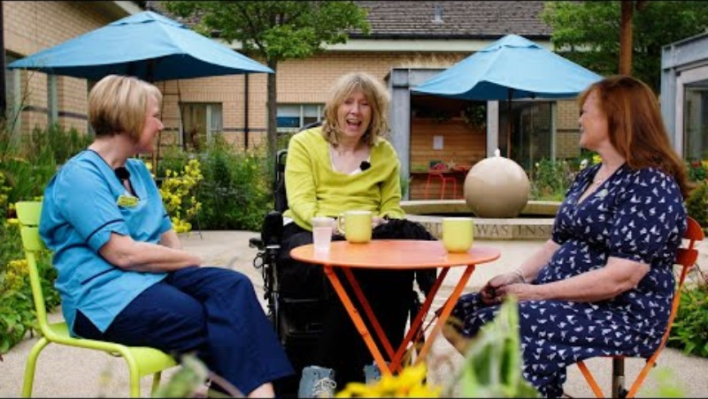

Slide 14
Thank you

