Slide 1


Education Commissioning & Training Plan for
2021/22
Stephen Griffiths, Director of Nursing and Executive lead for AHP and Healthcare Science, HEIW
May 2020
Version 2
@AaGIC_GIG
@HEIW_NHS
Trawsnewid y gweithlu ar gyfer Cymru iachach
Transforming the workforce for a healthier Wales

Slide 2

Context
COVID 19!!
COVID 19!!
COVID 19!!
@AaGIC_GIG
@HEIW_NHS
Trawsnewid y gweithlu ar gyfer Cymru iachach
Transforming the workforce for a healthier Wales

Slide 3
Context
COVID 19 – potential impact??
  Increased student attrition?
  Increased retirement?
  Increase/decrease in return to practice?
  Increased/decrease in application rates?
  Increased service demand long term impact on waiting times
  Decreased activity requiring greater level of service provision
  Impact on clinical placements for students and trainees
Education and training numbers for many staff groups are at the highest level for the past 20 years
Majority of students from 2018 start, have committed to work in Wales on graduation – but less than last year
@AaGIC_GIG
@HEIW_NHS
Trawsnewid y gweithlu ar gyfer Cymru iachach
Transforming the workforce for a healthier Wales

Slide 4
Health and social care workforce – Priorities for the next government The Health Foundation (2019)
Key messages for England (but position similar in Wales):
Workforce growth slower in the past decade compared to previous decade – despite growing need
Projects significant workforce shortages in some areas:
    Nursing - over 100,000 by 2028/29
    GP’s – number of patients per permanent GP continues to increase
Increasing skill mix to meet workforce needs:
    Pharmacists
    AHP
    Support workers
Conclusion of the report is that the NHS workforce needs to grow and there is a need to invest in education and training
@AaGIC_GIG
@HEIW_NHS
Trawsnewid y gweithlu ar gyfer Cymru iachach
Transforming the workforce for a healthier Wales

Slide 5
Approach for 2021/22
In recognising that investment in training and education is paid back within a very short time after graduation, Education and Training Plans will be based on workforce need – and the case made where this requires increased investment.
Recommendations within the paper will not be based on a single year’s workforce need but will be informed by:
    IMTP’s
    wider available workforce intelligence
    capacity within the system to support training/student/trainees.
Welsh Government will continue to sign off the Education and Training plan and will need to commit to expenditure in advance of the overall health budget being agreed – timescales for training
HEIW will engage with stakeholders (recognising the constraints COVID 19 is placing on this), to ensure:
@AaGIC_GIG
@HEIW_NHS
Trawsnewid y gweithlu ar gyfer Cymru iachach
Transforming the workforce for a healthier Wales

Slide 6
Current Annual Cycle
April – June:
  Collation of organisation education commissioning pro formas and staff projections
  Review against HEIW data and modelling
  Queries picked up with individual organisations
  Review of medical specialties and organisation submissions
  Engagement with stakeholders
June / July: Draft plan produced
July:
  CEO meeting
  NEB meeting
  HEIW Education, Commissioning and Quality Committee
  July / August: submission to Minister
  September / October: Decision on investment in professional healthcare education for following year covering all healthcare professional staff
@AaGIC_GIG
@HEIW_NHS
Trawsnewid y gweithlu ar gyfer Cymru iachach
Transforming the workforce for a healthier Wales

Slide 7
Current Recruitment Challenges identified in IMTP’s
Medical - varies across HBs and Trusts and Consultant/training/ SAS grades but includes: Psychiatry, GPs, Radiologists, Emergency Medicine, Oncologists, Trauma & Orthopaedics, General Surgery, O&G, Diabetes, Pathology specialties including Histopathology and Microbiology & Infectious Diseases, Care of the Elderly, Anaesthetics and ICM, Neurology, Paediatrics, Urology, Geneticist, Sexual Health, ENT, Gastroenterology, Rheumatology, Ophthalmology, Dental
Nursing – across the board including adult, child health, mental health (including CAMHS), practice nursing
AHPs – in a number of plans – including physiotherapy (including entry grade), SALT, OT, ODP, Dietetics, Orthoptists, Clinical Psychologists
Health Care Science - Radiographers, Sonographers, Cardiac Physiologists, Rehab Engineers, Nuclear medicine practitioner,
Pharmacy – less recruitment difficulties reported in this year’s plans
Not in all plans but in a number of plans: CBT and other psychological therapists including in primary care and CAMHS, all staffing groups across mental health services, IT technicians and Information Analysts, Estates staff, and experienced senior and executive level managers. PHW had recruitment difficulties across microbiology staffing.
Actions taken over past years will start to address some of these challenges e.g. increase in radiologist training numbers
@AaGIC_GIG
@HEIW_NHS
Trawsnewid y gweithlu ar gyfer Cymru iachach
Transforming the workforce for a healthier Wales

Slide 8
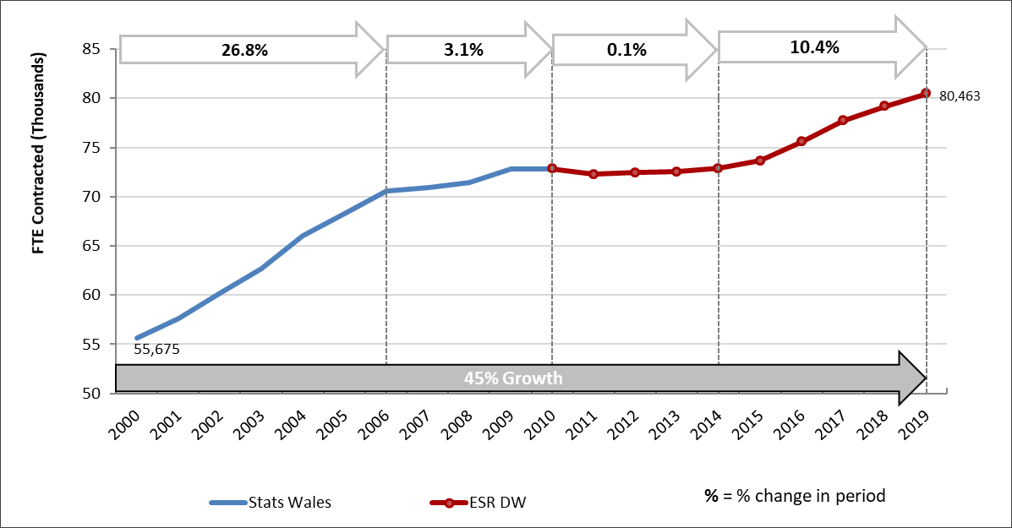
Overall Workforce growth - FTE Profile of the NHS Wales workforce 2000 – 2019
@AaGIC_GIG
@HEIW_NHS
Trawsnewid y gweithlu ar gyfer Cymru iachach
Transforming the workforce for a healthier Wales

Slide 9
HEIW RECOMMENDATIONS FOR 2021/22 ACADEMIC/TRAINING YEAR
@AaGIC_GIG
@HEIW_NHS
Trawsnewid y gweithlu ar gyfer Cymru iachach
Transforming the workforce for a healthier Wales

Slide 10
Medical Workforce
Specialty | Increase/Decrease required for August 2021
Emergency Medicine | +3 Higher Trainees to accommodate the ACCS coming through system +2 ACCS posts on the North Wales rotation
Anaesthetics | + 3 Higher Trainees to support workforce changes
Intensive Care Medicine | + 4 Higher Trainees
Obstetrics & Gynaecology | +2 ST1 in response to Maternity Care in Wales report
Paediatrics | + 4 additional ST1 posts to address the recommendations of the RCPCH workforce report
Community Sexual & Reproductive Health | Review in 2021
Medical Oncology | +3 Higher Training posts per year for 5 years to support the Cancer agenda
Clinical Oncology | +4 Higher Training Posts per year for 5 years to support the workforce modelling undertaken by the Royal College of Radiologists
Medical Microbiology | +3 Higher Trainees per year for 5 years (2nd year)
Radiology | Maintain intake of 20
@AaGIC_GIG
@HEIW_NHS
Trawsnewid y gweithlu ar gyfer Cymru iachach
Transforming the workforce for a healthier Wales

Slide 11
Medical Workforce
Specialty | Increase/Decrease required for August 2021
Internal Medicine | +15 Core Trainees change to Internal Medicine curriculum
Respiratory Medicine | +2 Higher Trainee to support future workforce requirements
Gastroenterology | +2 Higher Trainee to support future workforce requirements
Renal Diabetes & Endocrinology | No change and review in 2021
Acute Medicine | +4 Higher Trainees to support workforce expansion and retirements
Neurosurgery | A phased reduction of posts in line with trainees completing their training
General Surgery | +4 Higher Trainees to support future workforce requirements and the MTC workforce model
Trauma & Orthopaedics | No change
Plastic Surgery | +2 Higher Trainees to support the MTC workforce model
Urology | +4 Higher Training posts to support future workforce requirements and the Cancer agenda

Slide 12
More GPs
New model of GP training
  Implementation commenced
  160 Advertised GP training places with option to over-recruit (187 filled in 2019)
  Capacity to recruit to 200
  “1+2” model of GP Training (50 – 70%)
@AaGIC_GIG
@HEIW_NHS
Trawsnewid y gweithlu ar gyfer Cymru iachach
Transforming the workforce for a healthier Wales

Slide 13
Pharmacy
Pre registration Pharmacy – 170 combined multi sector places
Pharmacy Diploma
  remain at 40 places with HEI provider
  Increase advanced practice/extended skills budget to enable transformation of practice across sectors (see Advanced practice slide)
Pre-registration Pharmacy Technician – increase places from 45 to 55 with a number of these being multi-sector
@AaGIC_GIG
@HEIW_NHS
Trawsnewid y gweithlu ar gyfer Cymru iachach
Transforming the workforce for a healthier Wales

Slide 14
Workforce modelling for wider health professional workforce
HEIW has developed workforce tools to consider workforce supply
Underpinning assumptions
  Based on average of last 3 years turnover
  Based on retirement trends for the past 3 years
  Based on course attrition rates remaining stable
  The figures are considered conservative as:
  Policy position on ‘Commitment to work’ in Wales will come into effect in 2020/21
  Anecdotally there is an increase in retire and return rates
@AaGIC_GIG
@HEIW_NHS
Trawsnewid y gweithlu ar gyfer Cymru iachach
Transforming the workforce for a healthier Wales

Slide 15
What the modelling tells us
Between now and 2023 on average the workforce across nursing and AHP professions has the potential to grow considerably compared to 2018 baseline data and based on current trends
@AaGIC_GIG
@HEIW_NHS
Trawsnewid y gweithlu ar gyfer Cymru iachach
Transforming the workforce for a healthier Wales

Slide 16
*The estimates for 2024 are based on retaining 96% of graduates coming into the
Workforce from September 2020 due to the tie-in
@AaGIC_GIG
@HEIW_NHS
Trawsnewid y gweithlu ar gyfer Cymru iachach
Transforming the workforce for a healthier Wales

Slide 17
Adult Nursing Commissions 2014 - 2020

Slide 18
Pre-Reg Nursing and Midwifery Commissions 2014 - 2020

Slide 19
AHP Commissions 2014-2020

Slide 20
Recommendations
Wider health professional staff
Education commissions should continue strategy to support widening access by:
  Expanding the number of education programmes delivered through part time and shortened programmes
  Increasing the proportion of pre-registration nursing places delivered by the part time/distance learning route
  Expanding the provision of part time nursing places available to the care home sector.
@AaGIC_GIG
@HEIW_NHS
Trawsnewid y gweithlu ar gyfer Cymru iachach
Transforming the workforce for a healthier Wales

Slide 21
  Adult nursing places to increase from 1,400 to 1540
  Mental Health nursing places to increase from 356 to 410
  Child Nursing places to increase from 159 to 175
  Midwifery places to increase from 161 to 185
  Diagnostic radiography places to remain at 140
  Therapeutic radiography places to increase from 22 to 26
  Dietetics places to increase from 52 to 57
  Physiotherapy places to increase from 164 to 174
@AaGIC_GIG
@HEIW_NHS
Trawsnewid y gweithlu ar gyfer Cymru iachach
Transforming the workforce for a healthier Wales

Slide 22
  Paramedic to increase from 52 to ??
  Doctorate in Clinical Psychology places to increase from 29 to 32
  Healthcare science
    STP’s places to increase from 24 to 30,
    PTP BMS places to increase from 21 to 24
  Physicians Associates to remain at 54
  To increase the Advanced Practice budget by £500k from £1.5m to £2.0m*
  To increase HCSW budget by £500k from £2.0m to £2.5m*
  *increased to support the development of mental health workforce and clinical skills across the workforce
  Maintain investment in non medical prescribing programmes following significant increase last year
@AaGIC_GIG
@HEIW_NHS
Trawsnewid y gweithlu ar gyfer Cymru iachach
Transforming the workforce for a healthier Wales

Slide 23
Key messages
Due to the increasing investment in Health Professional education there are considerably more students in the system, expected to graduate, over the next few years. This together with other factors from our workforce modelling tools will inform the number of training places commissioned.
Medicine
Emergency medicine
Intensive care medicine
Internal medicine
Clinical oncology
  Wider health professional workforce
  Nursing - adult and mental health fields
  Midwifery
  Dietician
  Physiotherapy
  Mental health workforce
  Advanced practice and HCSW development
@AaGIC_GIG
@HEIW_NHS
Trawsnewid y gweithlu ar gyfer Cymru iachach
Transforming the workforce for a healthier Wales

Slide 24

Stephen.griffiths2@wales.nhs.uk
Pushpinder.Mangat2@wales.nhs.uk
Martin.riley@wales.nhs.uk
@AaGIC_GIG
@HEIW_NHS
Trawsnewid y gweithlu ar gyfer Cymru iachach
Transforming the workforce for a healthier Wales

