Slide 1
Equity, Diversity and Belonging (EDB)
Toolkit #1:
Awareness; Responsibility; Growth
Ketan Davé
Equity, Diversity and Belonging Lead, RCOT
Start

Slide 2
Introduction
We've developed this evidence-informed toolkit for every member of the occupational therapy workforce and RCOT community.
Equity, Diversity and Belonging (EDB) is more than a pit stop or a destination; it’s an ongoing journey. There’s no end point or destination, but a constant process of progress. We hope our interactive toolkit will help you on your EDB journey.
The journey starts with awareness. From there we can start to take more responsibility. Ultimately, it’s about growth in our understanding, knowledge, confidence and capacity to advocate, question and challenge. Growth to move beyond awareness to action. It’s ok to make mistakes; it’s ok to get things wrong; it’s ok to not understand.
Remember:
It is not easy.
It may be challenging and uncomfortable.
It is an ongoing journey.
Back
Next

Slide 3
Equity, Diversity and Belonging (EDB) What do we mean?
Equality simply means that everyone is treated the same exact way, regardless of need or any other individual difference. Equity is about everyone having what they need to make the most of the opportunities available to them in life.
In it’s broadest sense, diversity is any dimension that can be used to differentiate groups and people from one another. Our definition of diversity recognises that each one of us is unique and will therefore go beyond those defined in equality legislation. We will afford the same standards and principles to those with lived experiences.
Inclusion is a behaviour and belonging is a feeling or outcome of that behaviour; you cannot have belonging without inclusion. Our ambition is to nurture a culture of inclusion to foster a sense of belonging; inclusion alone is not enough.
For further information please visit:
https://www.rcot.co.uk/equity-diversity-and-belonging
Back
Next

Slide 4
Learning outcomes
In working through this toolkit, you will cover aspects of critical reflection and self-assessment relating to Equity, Diversity and Belonging (EDB), including the four stages of EDB competence.
We hope that through use of the toolkit you’ll have:
better awareness of your current level of EDB competence
improved understanding of the different dimensions of diversity
identified your next steps in translating that learning and awareness into action on your continuing EDB journey.
Back
Start

Slide 5
Please click this icon at any point to return to this page
Contents
1
EDB critical reflection
EDB critical self-assessment
Four stages of EDB competence
EDB competence: where are you now?
Dimensions of diversity
Transformation and growth: a process…
2
3
4
5
6
Back
Next

Slide 6
Return to contents page
EDB critical reflection
Ongoing critical self-assessment and reflection is a vital part of EDB. Each exercise in this toolkit will build layers into your self-assessment and reflection.
Before you start looking at your current EDB competence, ask yourself these questions.
Who am I? Where do my roots lie?
What have I experienced in my own life? Are there privileges and/or disadvantages that I’ve experienced or continue to experience?
What prompted me to access this toolkit? What does EDB mean to me?
Whose knowledge do I value? Whose perspectives have I ignored, overlooked or dismissed?
What do I fear?
(Anderson, 2022; Lerner, Kim, 2022; Sterman, Njelesani, Carr, 2022; Sterman, Njelesani, 2021)
Back
Next

Slide 7
Pick a box that best describes you:
Back
Next
EDB critical self-assessment
I am committed; an advocate and an authentic ally. I am critically self-reflective, consistently expanding my learning and I have a good grasp of EDB. I am intentional in my actions to realise equity in opportunity and in celebration of diversity to nurture a sense of belonging.
Champion
Click
EDB is not new to me; I am making progress through learning and self reflection. I often recognise opportunities for action but hesitate in my allyship. I am growing in confidence with some aspects of EDB and recognise gaps in my knowledge and understanding.
Improver
Click
EDB is new to me; I am learning but have limited confidence in this space. I may unknowingly express ideas that seem ignorant which I recognise as unhelpful. I’m at the start of this journey.
Beginner
Click
Return to contents page
I am largely indifferent, potentially even ignorant; I do nothing to advance progress but little to hinder it either. I am busy and haven’t really thought much about EDB.
Bystander
Click

Slide 8
Return to contents page
EDB critical self-assessment
Our EDB journeys are ongoing and involve constant self-reflection, self-critique, humility and growth; there’s no end point or ‘destination’, but a constant process of progress.
A visual representation of where you are and where you are heading on a journey can be useful, like a map. Having identified where you are, where’s next? How will you get there?
The following slides will continue to add layers of detail. We hope this will help you to formulate some of the actions you’ll need to undertake to continue to progress on your journey.
Bystander
Beginner
Improver
Champion
?
?
?
Back
Next

Slide 9
Return to contents page
Four stages of competence
What are the four stages of competence?
The four stages of competence model provides a suggested framework for the learning process. The model breaks down the learning process into four stages of learning from unconscious incompetence (ignorance) to unconscious competence (second nature).
How will they help me?
We’ve already agreed that Equity, Diversity and Belonging is not a pitstop but an ongoing journey. The four stages model will help you understand more about yourself and where you are on your journey. This will help your awareness of where the gaps are in your understanding and what you need to do to improve.
(Robinson, 1974; Black, 2015; Elliot et al., 2020; McKenna, Kyser, 2022)
Back
Next

Slide 10
Four stages of EDB competence: learn more Click anywhere on the background (Note: there are four objects to click through)
Unconscious
Incompetence
(Ignorance)
Click Here
Conscious
Incompetence
(Awareness)
Click Here
Conscious
Competence
(Learning)
Click Here
Unconscious
Competence
(Second nature)
Click Here
Unaware of their skills and their lack of proficiency
Aware of the skills gap but not yet proficient
Able to use their skills, but only with effort
Performing the skills becomes automatic
Back
Return to contents page
Next

Slide 11
EDB competence: where are you now?
Click on the relevant box below
Unconscious
Incompetence
Conscious Incompetence
Conscious Competence
Unconscious Competence
Back
Return to contents page
Next

Slide 12
Unconscious Incompetence ‘I don’t know what I don’t know’
Back
Next
Here, you lack knowledge and understanding around a particular area or skillset. You are unaware of this and may not recognise the value of new skills, learning and growth, or its’ potential impact. Equally, you may not recognise incompetence relating to EDB, for example, nor see that a knowledge or skill gap exists.
Moving forwards to the second stage requires critical self-reflection and acknowledgment that there are gaps in knowledge, understanding and skillsets. To move forward from unconscious incompetence, you must have grown in your self-awareness and critical reflection to accept that learning and growth could be useful to self and others.
Return to contents page

Slide 13
Back
Conscious Incompetence ‘I know what I don’t know’
In the second stage, you’ve accepted that a knowledge gap exists; a realisation of what you don’t know. This can be an uncomfortable experience for some.
To progress, you must recognise the value of a new skill and move to being curious and motivated to learn.
Moving through this stage and forwards, there’s a clear shift from awareness to action.
Return to contents page
Next

Slide 14
Conscious Competence ‘I grow and improve and that slowly shows’
Back
Next
In the learning stage, you do what it takes to develop some degree of competency. This may take various forms, be supported by others alongside a continuous cycle of critical self-assessment and reflection to embed and apply learning.
You are a novice working towards knowledge and skill acquisition with a focus continuous improvement; you’re learning.
Return to contents page

Slide 15
Back
Next
Unconscious Competence ‘I go with the flow thanks to my level of knowledge’
Eventually, skills are mastered, knowledge acquired and their application becomes second nature. Learning is a continuous and ever-evolving process, but you’ve established a strong foundation. You are confident in your abilities while continuing to expand knowledge, understanding and skills.
It’s important to remind ourselves that ‘destinations’ of knowledge and competence risk complacency and ignorance. This can perpetuate stereotypes, assumptions; harm. Our EDB journeys are ongoing and involve constant self-reflection, self-critique, humility and growth; there’s no end point or ‘destination’, but a constant process of progress.
Return to contents page

Slide 16
Back
Next
Unconscious Incompetence
with greater awareness and education, you will progress to:
Conscious Incompetence
with training; learning and action towards change you will progress to:
Conscious Competence
with continued learning, action and practice you will progress to
Ongoing critical self-assessment and reflection is vital in any EDB journey
Unconscious Competence
(Robinson, 1974; Black, 2015; Elliot et al., 2020; McKenna, Kyser, 2022)
Return to contents page

Slide 17
Dimensions of diversity
Back
Next
Language
Appearance
Work context including location, role, title, seniority
Neurodiversity
Employment and/or work experience
Culture and/or heritage
Family circumstances
Political viewpoint
Formal
education
Income
and/or financial
stability
Communication style
Hobbies and interests
Caring responsibilities
Geographical location
Health
Relationship status
Housing
Childhood/early life experiences
A diversity wheel can be another helpful aid to critical self-reflection or discussion with others. There are various examples readily available online, this one is adapted from a version by Equality At Work.
In our version, we’ve combined the protected characteristics that are defined by the Equality Act 2010* (inner pieces), with some suggestions of additional dimensions of diversity (outer pieces).
A separate download of the wheel is available here.
It’s important to remember that our identities are complex and intertwining; many individuals’ identities will intersect multiple dimensions of diversity.
*
Marital/civil partnership status
Age
Disability
Sexual orientation
Gender reassignment
Pregnancy/ maternity leave
Sex
Race
Religion or belief
Dimensions of diversity
RCOT, 2023
*The Equality Act 2010 applies to England, Scotland and Wales. The Act does not apply to Northern Ireland. In Northern Ireland, equality and anti-discrimination law is not yet consolidated into one single act. .
Return to contents page

Slide 18
Back
Next
Diversity wheel exercise
Language
Appearance
Work context including location, role, title, seniority
Neurodiversity
Employment and/or work experience
Culture and/or heritage
Family circumstances
Political viewpoint
Formal
education
Income
and/or financial
stability
Communication style
Hobbies and interests
Caring responsibilities
Geographical location
Health
Relationship status
Housing
Childhood/early life experiences
A diversity wheel can be a helpful aid to critical self-reflection or discussion with others.
Please take some time here to challenge yourself and/or colleagues to think about the dimensions of diversity prompted by this wheel.
Questions: Are there additional dimensions or characteristics of diversity that you’d add?
Revisit your earlier EDB critical reflection - are there aspects of your own identity that you ignore, overlook or dismiss? What about others’?
Are you able to identify future actions for yourself and your EDB journey based on prompts from the wheel?
Marital/civil partnership status
Age
Disability
Sexual orientation
Gender reassignment
Pregnancy/ maternity leave
Sex
Race
Religion or belief
Dimensions of diversity
RCOT, 2023
Return to contents page

Slide 19
Back
Next
Diversity wheel exercise 2
Language
Appearance
Work context including location, role, title, seniority
Neurodiversity
Employment and/or work experience
Culture and/or heritage
Family circumstances
Political viewpoint
Formal
education
Income
and/or financial
stability
Communication style
Hobbies and interests
Caring responsibilities
Geographical location
Health
Relationship status
Housing
Childhood/early life experiences
Suggested group exercise: ask each person to pick the aspects of diversity from the wheel that really define their identity, and, if comfortable, to share with the group.
People often tend to share from the outer pieces rather than the inner pieces; a point of reflection in itself. The exercise will almost always prompt groups to learn something new about each other and increase awareness of themselves.
Questions: Are there some dimensions of diversity that are easier disclosed or talked about than others? Some better understood than others? Some that experience greater privilege or disadvantage? What about when dimensions of diversity intersect or combine?
Marital/civil partnership status
Age
Disability
Sexual orientation
Gender reassignment
Pregnancy/ maternity leave
Sex
Race
Religion or belief
Dimensions of diversity
RCOT, 2023
Return to contents page

Slide 20
Transformation and growth A process…
Back
Next
Transformation and growth, moving through those stages of competence, is not always easy. Particularly relating to Equity, Diversity and Belonging, the learning and transformation process can be uncomfortable and challenging.
It’s ok to make mistakes; it’s ok to get things wrong; it’s ok to not understand.
Growth comes from wanting to remedy our mistakes; wanting to get things right; learning to better understand. This is where we translate awareness into action.
We hope that this toolkit has prompted and/or supported some critical self-reflection and self-assessment with respect to Equity, Diversity and Belonging. You can, and are encouraged to, return to this resource at any time. Please remember those three points we started with:
It is not easy.
It may be challenging and uncomfortable.
It is an ongoing journey.
Return to contents page

Slide 21
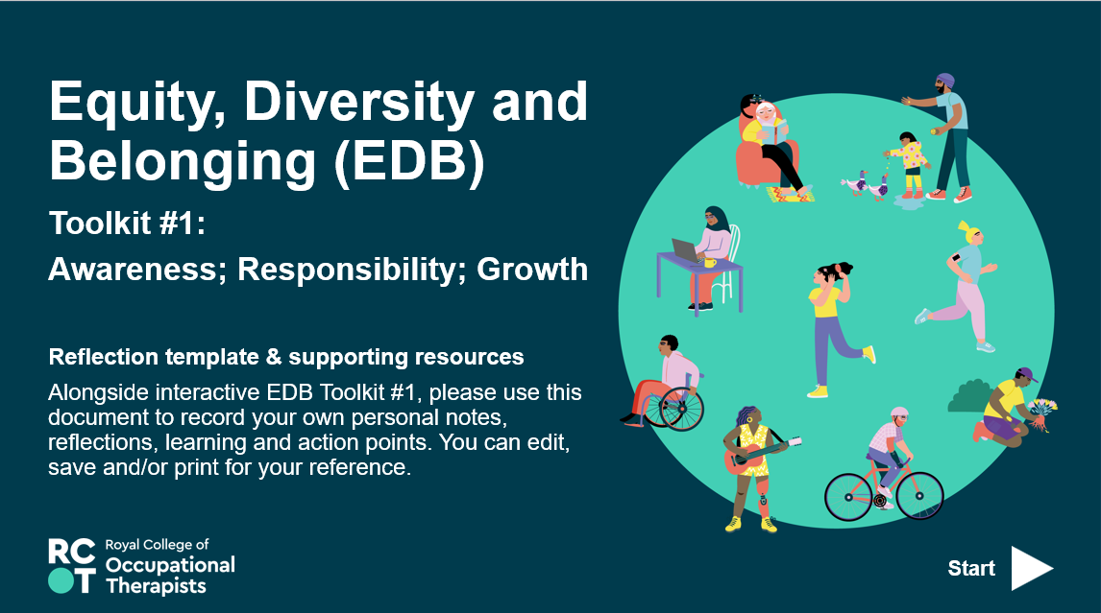
Review and next steps
Back
Next
Thank you for accessing this evidence-informed toolkit. We hope you have found it useful.
In working through this toolkit, you will have covered aspects of critical reflection and self-assessment relating to Equity, Diversity and Belonging (EDB), including the four stages of EDB competence. We hope that, through use of the toolkit, you will have better awareness of your current level of EDB competence, your understanding around the different dimensions of diversity, and what your next steps might be in translating that learning and awareness into action in your continuing EDB journey.
Please double click the picture (left) to access the EDB critical self-assessment which compliments this toolkit.
There are some further links and recommended reading available via CPD@RCOT
Click here to access EDB Reflection
Return to contents page

Slide 22
Back
Next
References
Anderson, S. H. (2022) ‘Cultivating Cultural Humility in Occupational Therapy through Experiential Strategies and Modeling’, The Open Journal of Occupational Therapy, 10(4), 1-7, doi: 10/15453/2168-6408.1962
Black, S. A. (2015) ‘Qualities of Effective Leadership in Higher Education’, Open Journal of Leadership, 4, 54-66. Published Online June 2015 in SciRes. http://www.scirp.org/journal/ojl doi: 10.4236/ojl.2015.42006
Elliot, D.L., Bengtsen, S.S.E., Guccione, K., Kobayashi, S. (2020). What Is the Hidden Curriculum?. In: The Hidden Curriculum in Doctoral Education. Palgrave Pivot, Cham. https://doi.org/10.1007/978-3-030-41497-9_1
Equity at Work (2023) Diversity is Race and Gender and So Much More. Online. Available at: https://equity-at-work.com/theequityatworkblog/diversity-is-race-and-gender-and-so-much-more
Great Britain Parliament (2010) Equality Act 2010. London: Stationery Office. Available at: https://www.legislation.gov.uk/ukpga/2010/15/contents
Lerner, J. E., Kim, A. (2022) ‘Developing an Anti-Racist Practice in Occupational Therapy: Guidance for the Occupational Therapist’, The Open Journal of Occupational Therapy, 10(4), 1-13. doi: 10.15453/2168-6408.1934
Mckenna, K., Kyser, C. D. (2022) ‘Beyond academic writing: The international doctoral student writing workshop’, Innovations in Education and Teaching International, 59:4, 375-386, DOI: 10.1080/14703297.2021.1878051
Return to contents page

Slide 23
Back
Next
References (2)
Robinson, W. L. (1974). Conscious Competency—The Mark of a Competent Instructor. The Personnel Journal—Baltimore, 53, 538-539
Rolfe, G., Freshwater, D., Jasper, M. (2001) Critical reflection in nursing and the helping professions: a user’s guide. Basingstoke: Palgrave Macmillan.
Sterman, J., Njelesani, J., Carr, S. (2022) ‘Anti-racism and Occupational Therapy Education: Beyond Diversity and Inclusion’, Journal of Occupational Therapy Education, 6(1). doi: 10.26681/jote.2022.060103
Sterman, J., Njelesani, J. (2021) ‘Becoming Anti-Racist Occupational Therapy Practitioners: A Scoping Study’, OTJR: Occupation Participation and Health, Vol 41(4), 232-242, doi: 10.1177/15394492211019931
Return to contents page

Slide 24
Back
Next
Acknowledgments
With thanks to
Emma Grover
Professional Development Lead, RCOT
Hannah Spencer
Occupational Therapist
For further information please visit:
https://www.rcot.co.uk/equity-diversity-and-belonging
Or email ketan.dave@rcot.co.uk
Return to contents page

Slide 25
Return to title slide
Back
Return to contents page

